Slide 1


Company
Presentation

Slide 2











Our vision
to be customers’ first choice
as the best in Class Global Electronics
Manufacturing Solutions Provider
- your strategic global partner

Slide 3

Our major timeline
- Major Expansion
Became Lead Free
Web Base Material
Planning
Sony 5ppm award
Listed in Stock Exchange of Thailand (SET)
TPR 6K Sqm. expansion
Flip Chip
Clean room class 100K
Implement Bar Code
Certified ISO18001
Thailand Lean Award
Lean Best Practice Award
Zero Accident Award
Health, Safety & Environment in Workplace award
1st 2.5K sqm Factory
In Rangsit (TPR)
Forbe Asia Best
Under 1B$ Award
Deloitte Technology
Fast 500 Asia Pacific
Pioneer Best supplier award
Export to International Markets
Became
CFC Free
Certified
ISO9002
Start
DFM
COB
Zero Accident Award
1990 1992 1994 1996 1998 2000 2002 2004 2006 2008 2010 2012
TPP 10K Sqm.
Expansion
IPO office in
Singapore
Certified ISO13485
Early Adopter of SMT Placement
Design Functional Testers
2nd 5K sqm Factory in Prachinburi (TPP)
Pioneer Best supplier award
Start Corporate
Improvement Team
Denmark office
Zero accident award
Health, Safety & Environment in Workplace award
Listed in Thailand Stock Exchange as
3rd company in MAI
Integrated ERP, AOI & BGA Xray
Certified TS16949, ISO 14001
Merged TT&TP

Slide 4
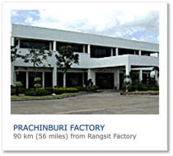
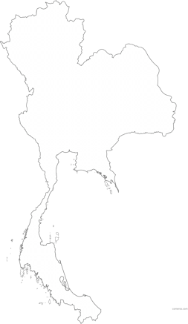

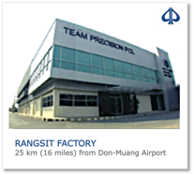
Our facilities
23,200
Sq. M
Prachinburi
Factory
total area under the building
Rangsit
Factory
Sales office in DENMARK
Logistics supply chain office in SINGAPORE

Slide 5
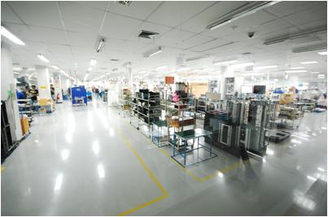
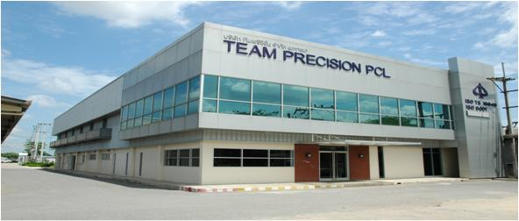
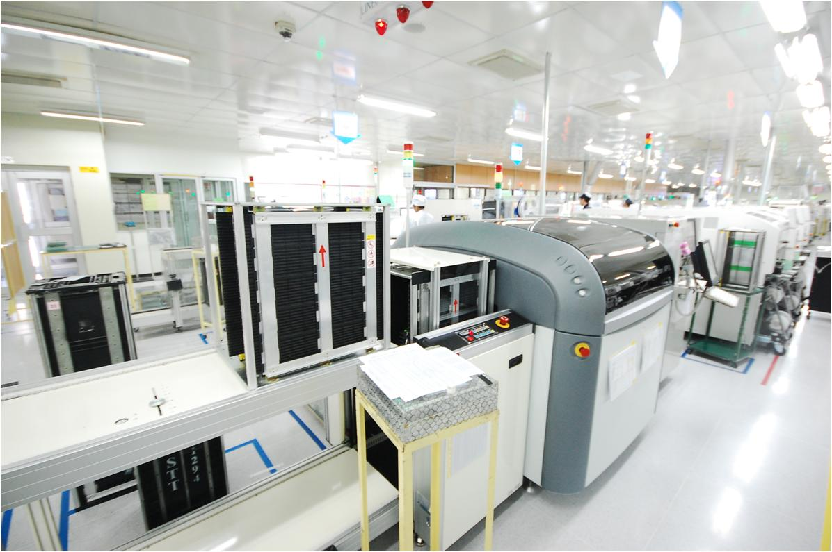










Rangsit Factory

Slide 6
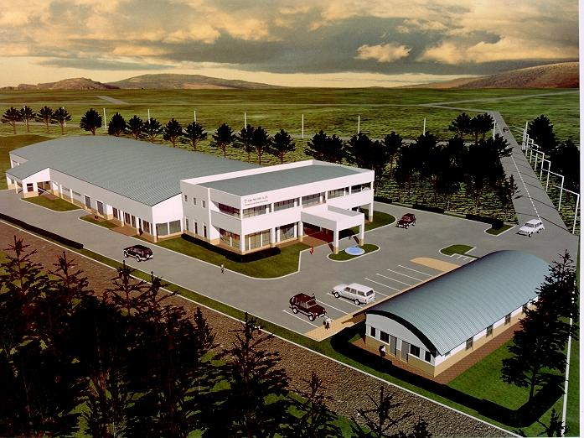
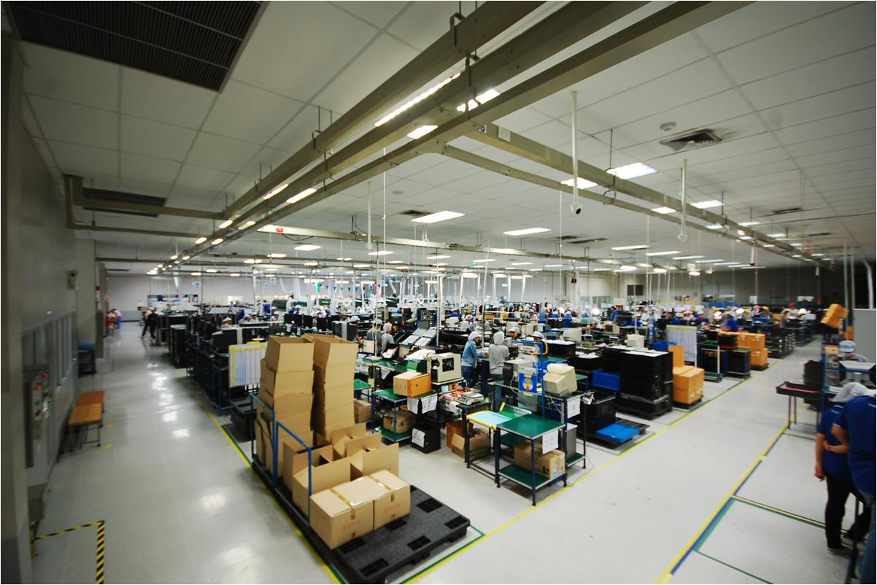
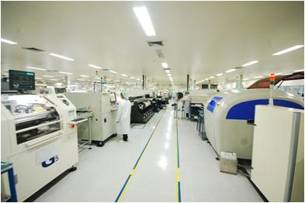
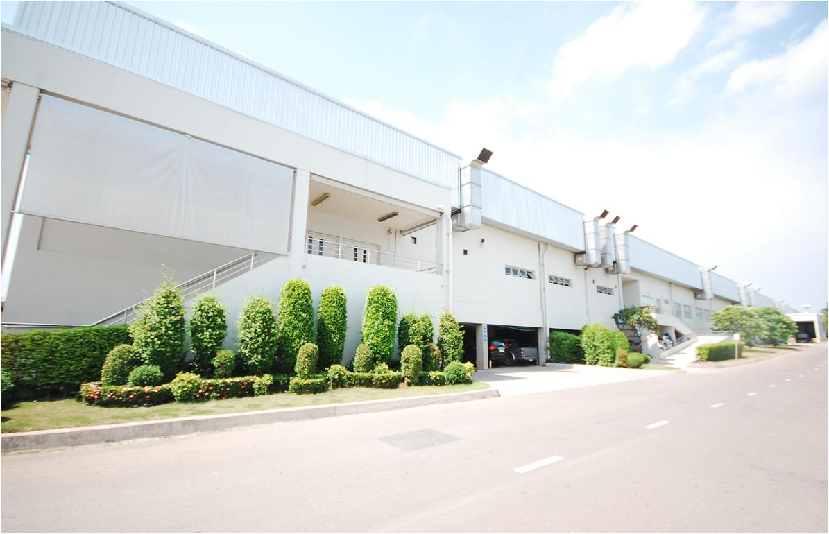
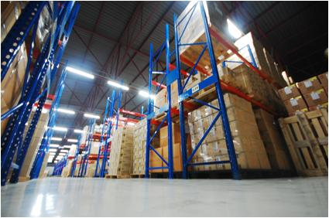

Prachinburi Factory

Slide 7
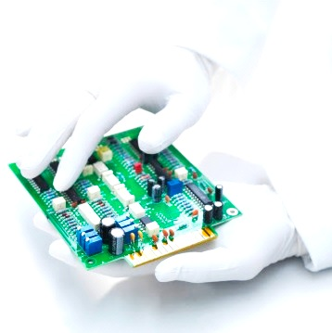

Our employees
1,314
headcounts
management | 58
engineer | 76
admin staff/supervisor | 260
technician | 100
operator/other | 820

Slide 8

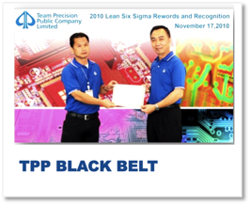
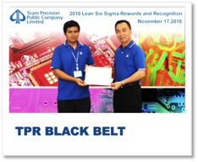
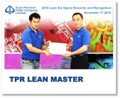
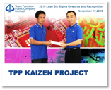
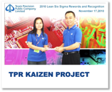
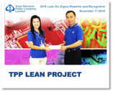
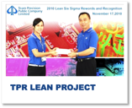
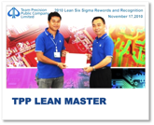
Our quality people
in-house training department
continuous staff training & development on all levels
all workers are certified for skill level
2 in-house IPC A-610 certified trainer
2 certified Six Sigma Black Belt
2 certified Lean Master
86 Trained Green Belt

Slide 9
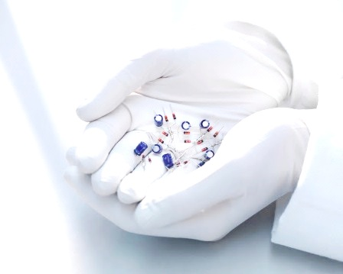





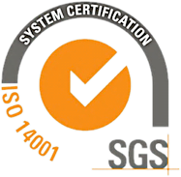
Our certified standards

Slide 10

Our Lean SIGMA project
2008
key focus:
OPERATION IMPROVEMENT
2011 (Lean Six Sigma Integration)
outcome
42 PROJECTS
outcome
228 PROJECTS
43 KAIZENS
1 LEAN MASTER
10 PROJECTS
70 KAIZENS
28 PROJECTS
85 GB + 7 HOC
4 Lean Six Sigma Black Belt
2009
2010
2012
outcome
outcome
42 PROJECTS
Target to be done
80 PROJECTS
90 KAIZENS
170 PROJECTS
54 KAIZENS
7 PROJECTS
36 LEAN CHAMPIONS
70 KAIZENS
15 PROJECTS
8 PROJECTS
2 LEAN MASTERS
10 PROJECTS
16 PROJECTS
3 Lean Six Sigma Black Belt
1 BLACK BELT
2 BLACK BELTS

Slide 11
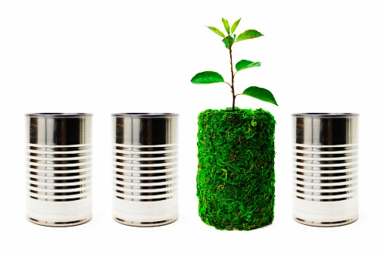
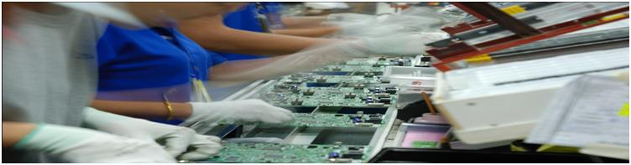
Environmental friendly
ISO 14001 Certified
Lead Free Process since 2002
CFC Free Factory since 1998
Clean Operation Conscious
Non Smoking Factory
RoHS and REACH Compliance

Slide 12
Our product experience
RF
products
audio products
cellular antenna
medical instrument
white goods
electronics sensors
security systems
sound synthesizer
industrial controller
safety products
RF products
medical instrument
audio product
white goods
cellular antenna
electronic sensors
security systems
sound synthesizer
industrial controller
safety products

Slide 13





our success stories
2002
2006
2007
2007
awards
Awarded For Reaching 5 Ppm Quality Level
Best Supplier Award
Best Supplier Award
Deloitte Touché Tohmatsu – Technology Fast 500 Asia Pacific 2007
Nominees By Stock Exchange Of Thailand And Money & Banking Magazine For Best Performance Award Technology Sector
Forbes Asia Business Magazine – Best under a $Billion Award

Slide 14







Our success stories
2009
2010
2011
2012
awards
Zero Accident 2009
Zero Accident 2010
Zero Accident 2011
Zero Accident 2012
Thailand Award Lean 2009
Excellent Safety Health & Environment in Workplace 2009
National Award for Excellent Safety, Sanitary & Environment in 2010 by Ministry of Labor
National Award for Excellent Safety, Sanitary & Environment in 2011 by Ministry of Labor
National Award for Excellent Safety, Sanitary & Environment in 2012 by Ministry of Labor
Lean Best Practice
Award 2009

Slide 15


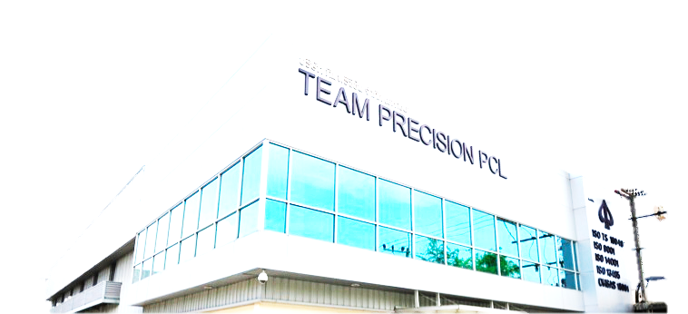
Team Precision - Competitive Advantage
world class capabilities
professional staffs
high velocity supply chain
lean sigma quality
reliable services
intellectual property protection
long term relationship

Slide 16


Thank you

